Slide 1
Secure Messenger Design
Animish Phatak
Pridhvi Muthuraju

Slide 2
The Setup
Architecture
There are two types of entities: Server and Clients.
Assumptions
The clients have the Public Key of the Server (PK_{server}).
The server has the usernames and SHA256 hash of the Password of all the users.
Services
Perfect Forward Secrecy, Confidentiality, Authentication, Integrity, Non-Repudiation, and Endpoint Hiding.
The application runs on UDP protocol to avoid connection-based attacks.
Notes:
Complete endpoint hiding is provided in the login and logout protocols. Partial endpoint hiding is provided in the client-to-client communication protocol.

Slide 3
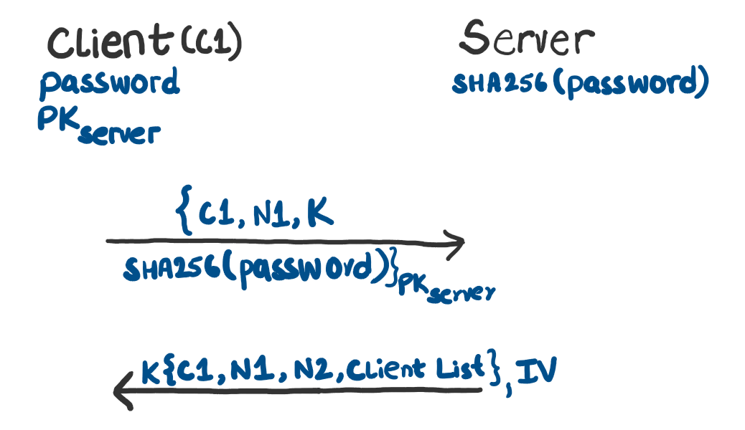
Protocols
Login Protocol
*
The SHA256 hash of the password authenticates the client to the server
N₁ is a nonce that authenticates the server to the client
K is a 256-bit shared key generated by client and used to encrypt communication between server and client (used in “login”, “list”, and “logout”)
N₂ is a nonce that will be later used in the logout protocol
*The hash of the password is stored salted to prevent offline password attacks
Notes:
Symmetric encryption algorithm is AES256.
N1 and N2 are randomly generated 10 bytes values.
The password entered by the user while logging in is hidden from view.

Slide 4
Protocols
Login Protocol
Client List for C1
Username | IP | Port | Shared Secret Key
C2 | 10.0.0.10 | 10643 | a55a…20be
C3 | 10.0.0.11 | 10520 | 532b…5a2c
…
Shared Keys
 | C1 | C2 | C3 | …
C1 | N/A | a55a…20be | 532b…5a2c
C2 | a55a…20be | N/A | 007c…7c47
C3 | 532b…5a2c | 007c…7c47 | N/A
… |  |  |  | N/A
The server maintains a table with shared keys for each client pair
A shared key is a randomly generated 256-bit value assigned to each client pair
Each client receives a custom client list which includes the corresponding shared key
Whenever a new client logs in, the updated shared keys table is sent to all the logged in clients
Notes:
The Shared Keys are 256-bit keys used in the AES256 symmetric encryption algorithm.
Shared Keys table is implemented via OOP classes. Each logged in client is defined as a variable of a class which stores the relevant client shared secret keys, client addresses, server shared keys, usernames, and nonces.
The “List” command which provides the updated client list to a client from the server can be explicitly called. It is also implicitly called whenever a new client logs in, or an existing client logs out.

Slide 5
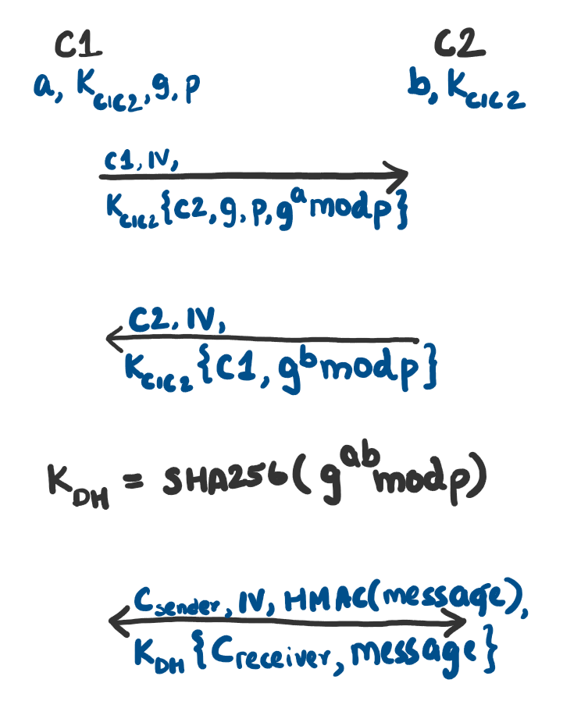
Protocols
Key Establishment and messaging protocol
The shared key, K_{c1c2}, is used to encrypt the Diffie-Hellman parameters used to setup the final shared key, K_{DH}
The protocol supports partial endpoint hiding
This authenticates the clients mutually and prevents MITM attacks while setting up K_{DH}
HMAC of the messages are included to provide integrity and authentication
Notes:
p is a 2048 bit prime generated by the cryptography.hazmat library
K_{DH} is hashed with SHA256 to generate a 256-bit key for AES256 symmetric algorithm.

Slide 6
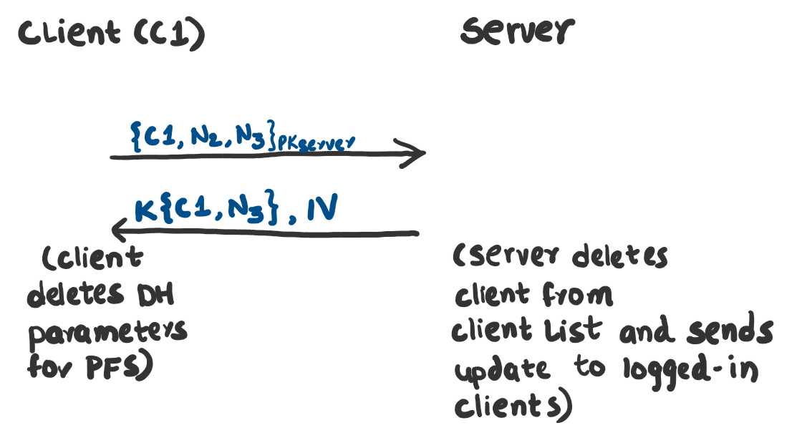
Protocols
Logout protocol
Encrypting the logout request from the client with server’s public key allows full endpoint hiding
N₂ (from Login protocol) is used to prevent de-authentication attacks by legitimizing the logout request
N₃ is a nonce used to prevent replay attack where a previous logout response from the server can be used to trick the client to think it has logged out
Perfect Forward Secrecy is provided by forgetting a, b, and K_{DH} at the end of the logout process
Notes:
N2 and N3 are randomly generated 10 bytes values.

